Slide 1
Dungeon Bomb
By: Bradley Stukas, Benjamin Gonzalez and Yumi Park

Slide 2

Game Overview

Slide 3
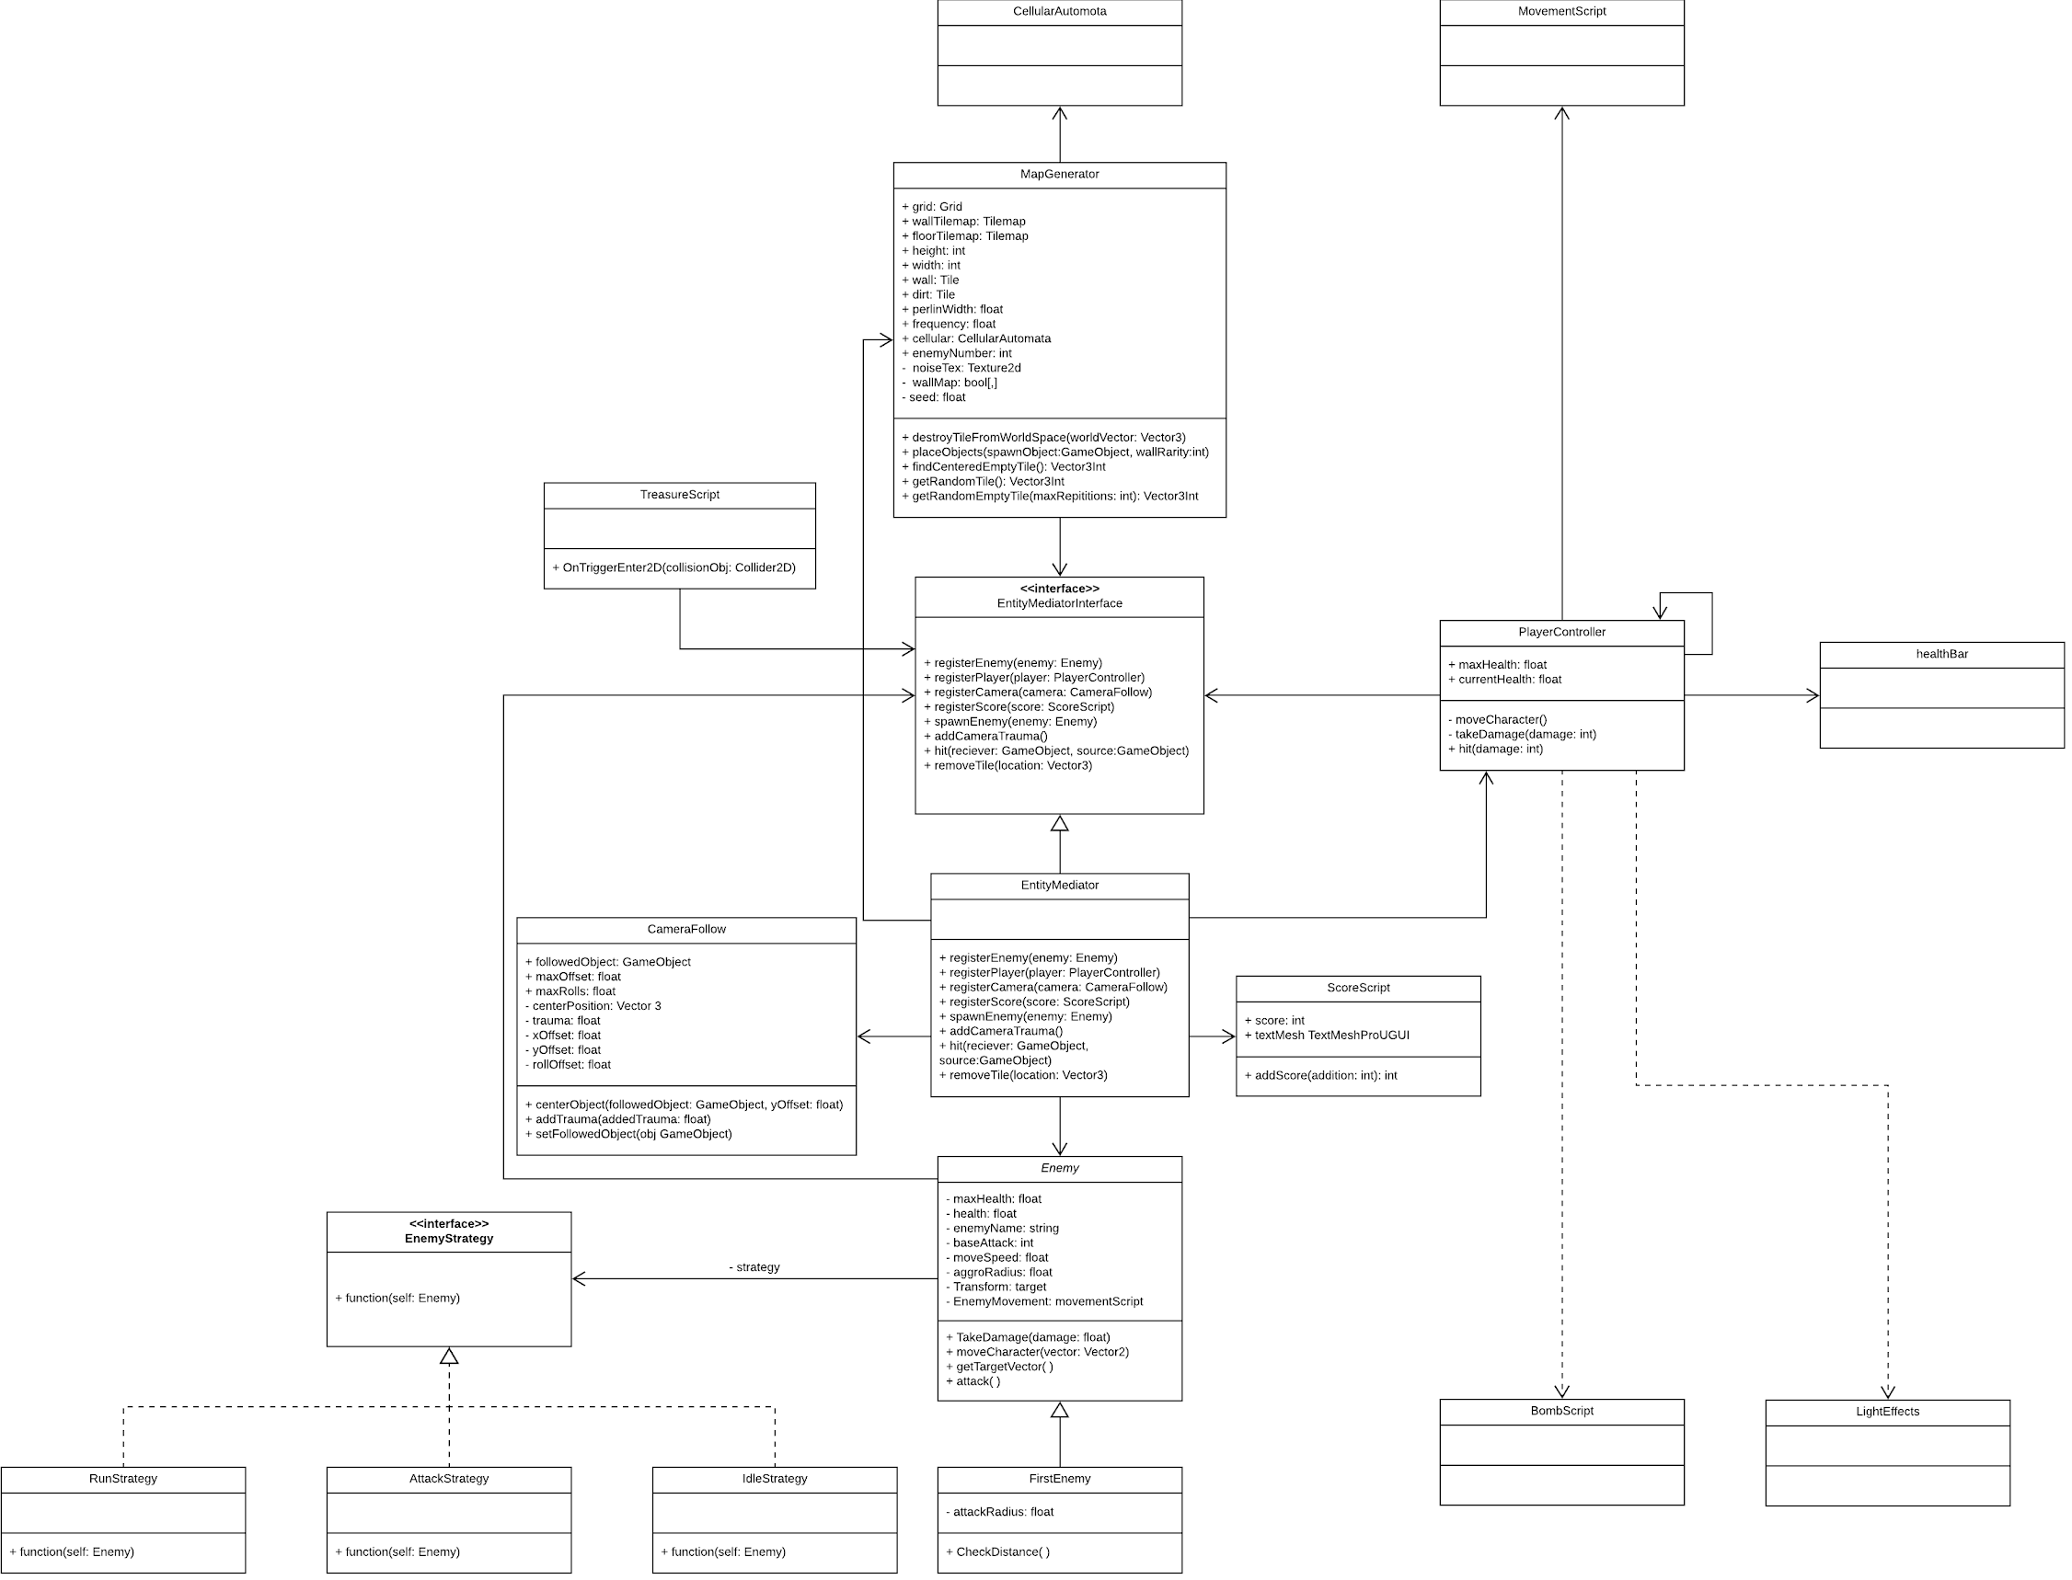
Design Patterns
Strategy: Enemy A.I.
State: Animation State
Singleton: PlayerController
Mediator: Entry

Slide 4
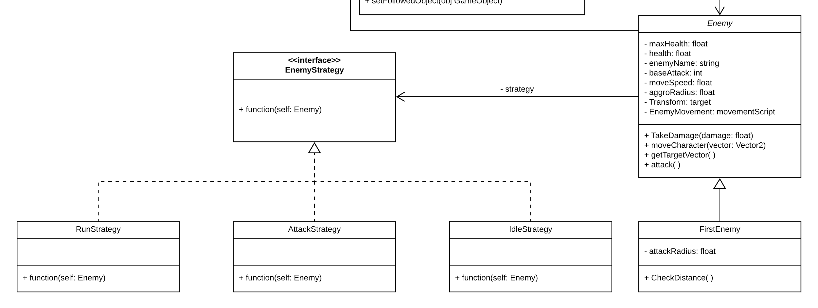
Strategy
Enemy A.I.

Slide 5

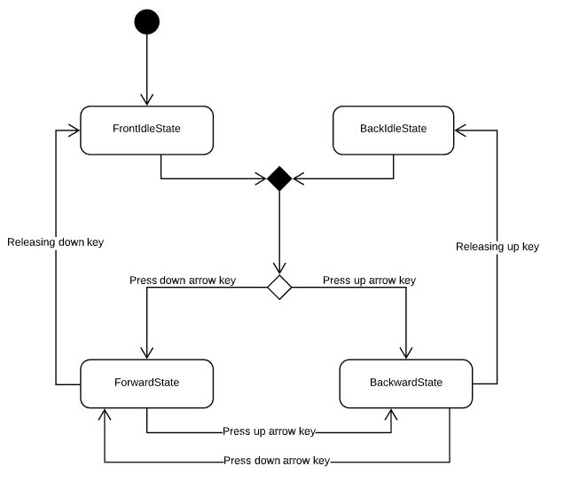
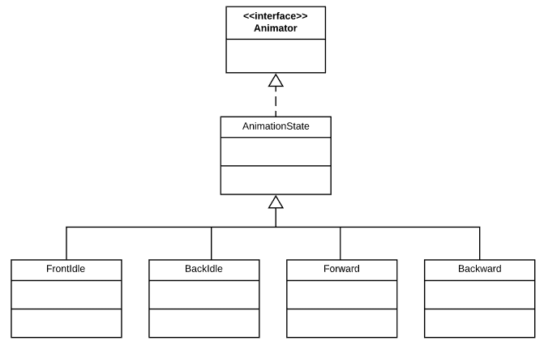
State

Slide 6
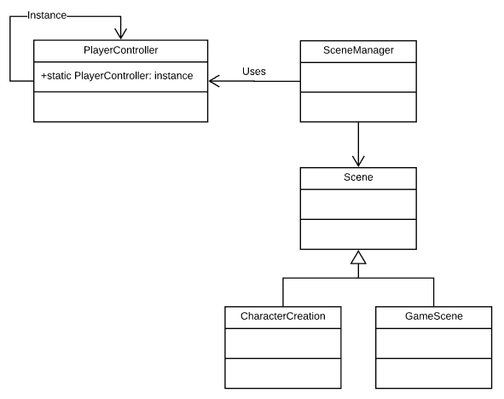
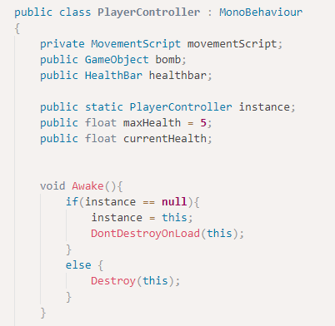
Singleton

Slide 7
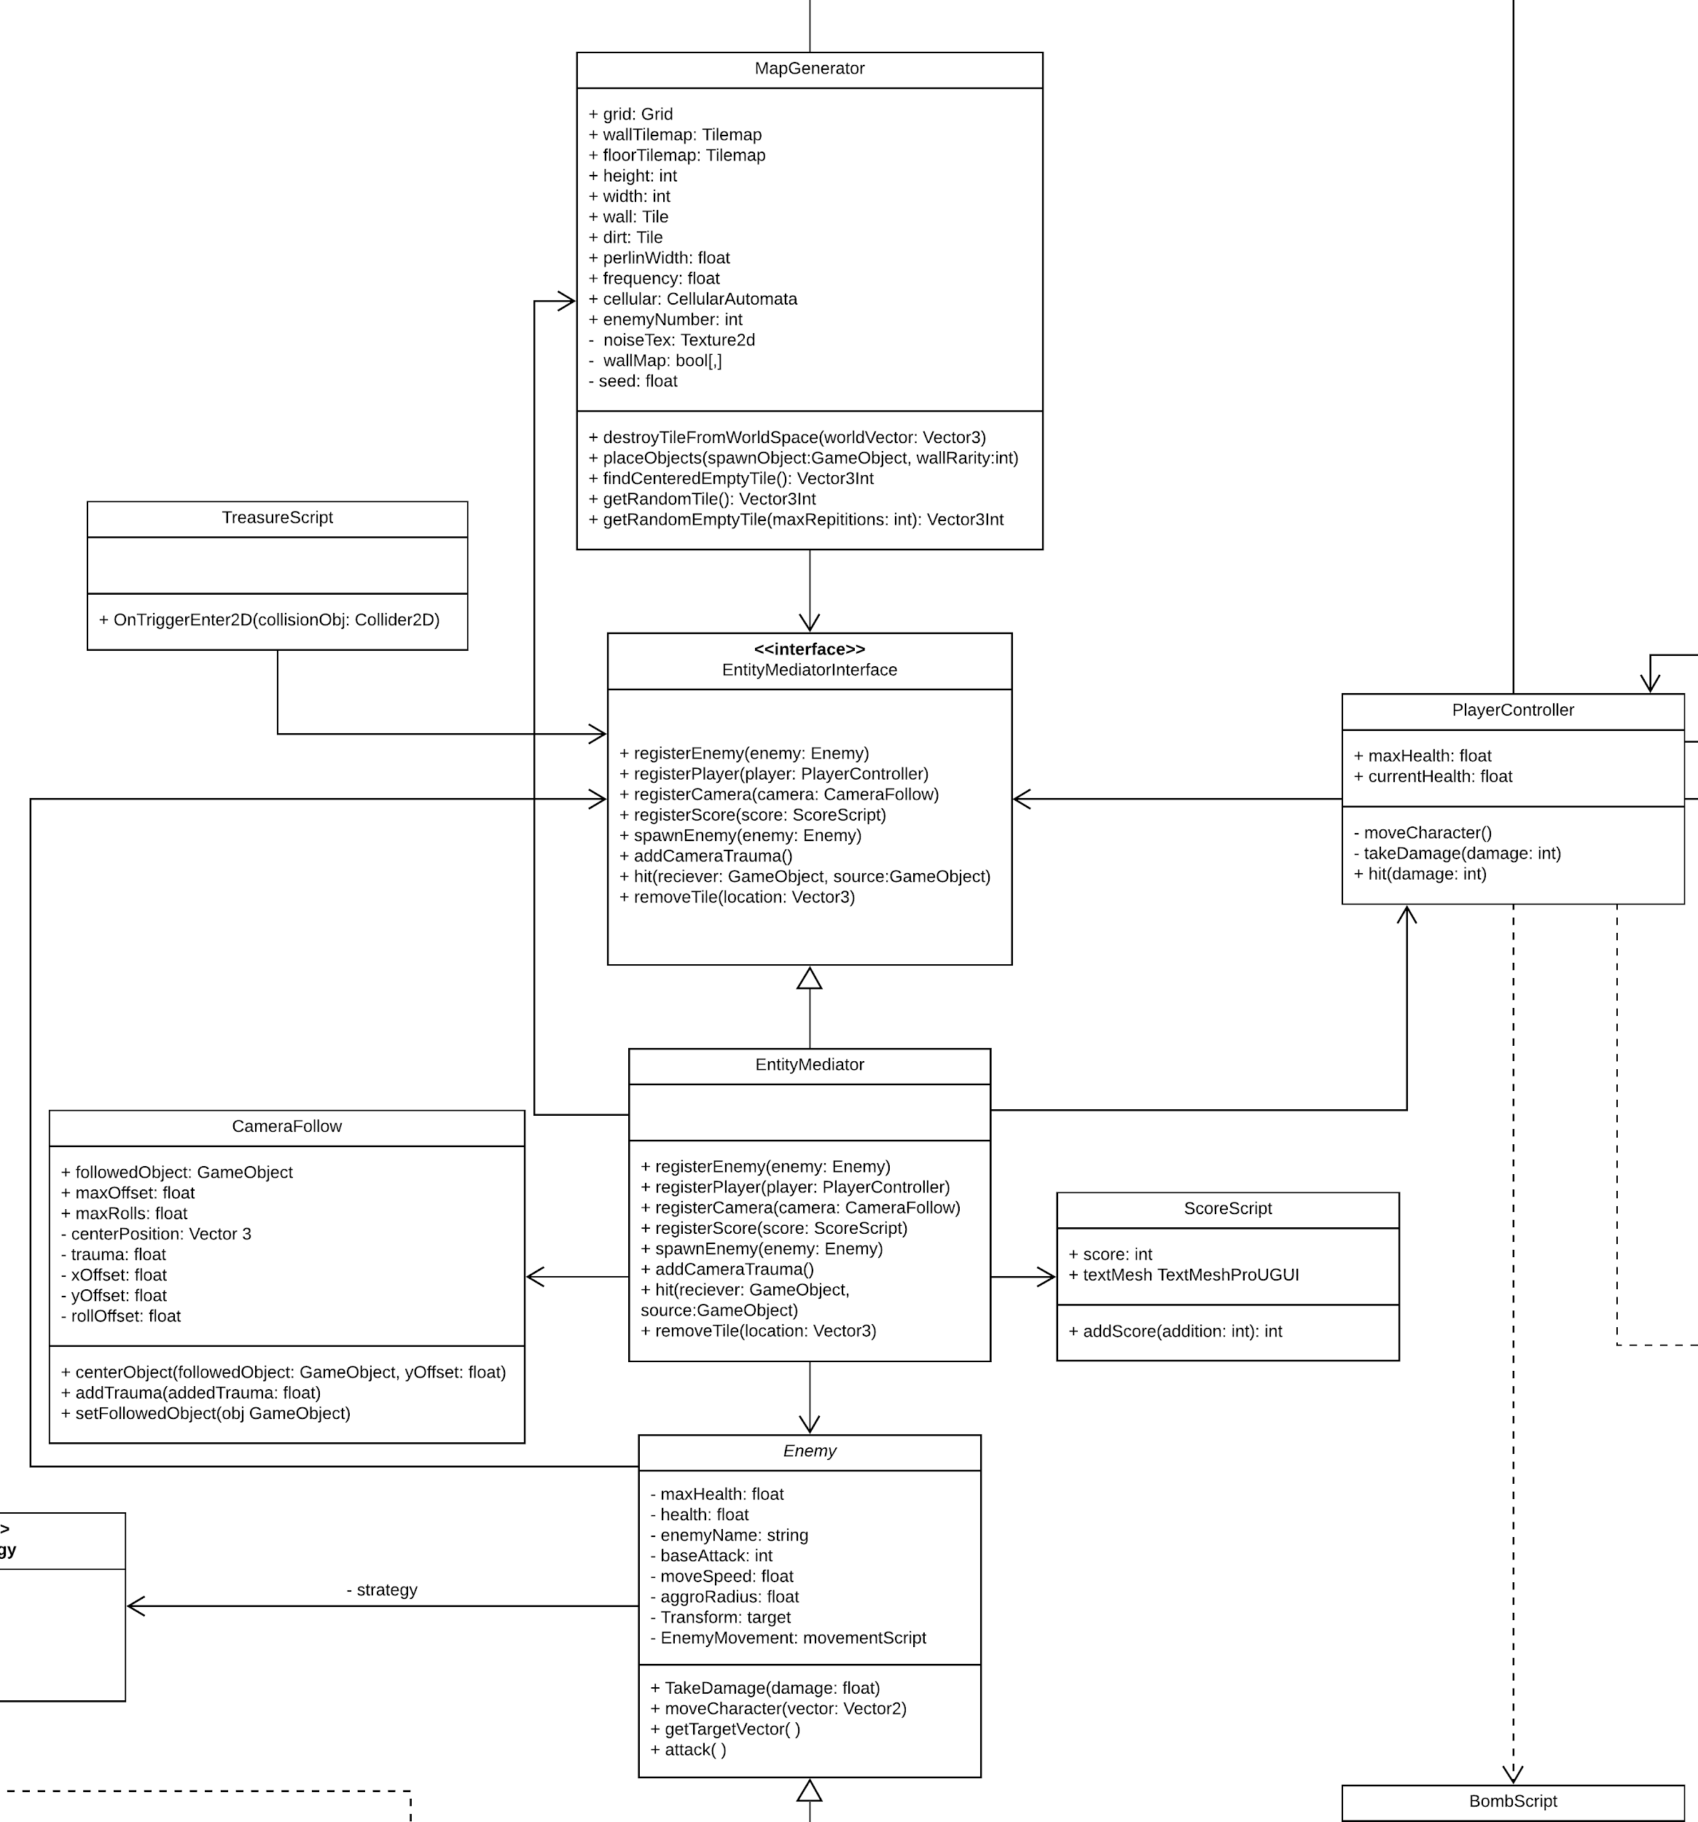
Mediator

Slide 8
Progress Updates
Code 70%
Design 85%
Proposal
100%
Overall 80%
Main Features We Wanted:
Character creation
Procedurally generated dungeon layout
Character movement
Treasure Placement and Pick-up
Breakable walls using bombs
Custom textures
Finish Real-time combat system
Sound effects
Multiple enemy types
Multiple weapon types
Fine tuning

Slide 9
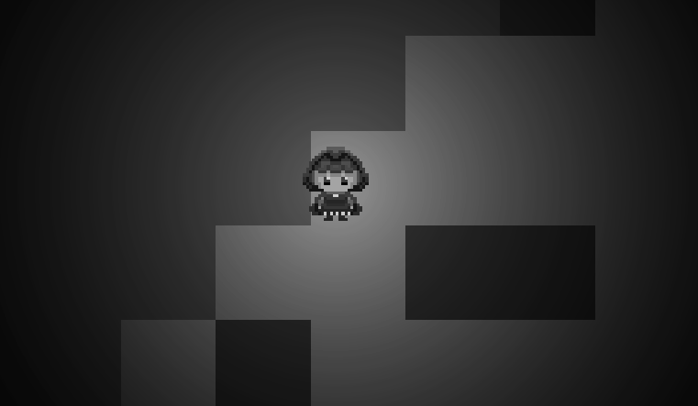
Game Demo

Slide 10

Lessons Learned
Unity: Learning Unity can sometimes be hard
Unity Tools: Learned how to use some of Unity’s features like the Collab feature.
Implementing Design Patterns: Learned how to apply the design patterns to a game.
Communication: Used tools like Discord to keep in touch easily along with status updates

